Slide 1
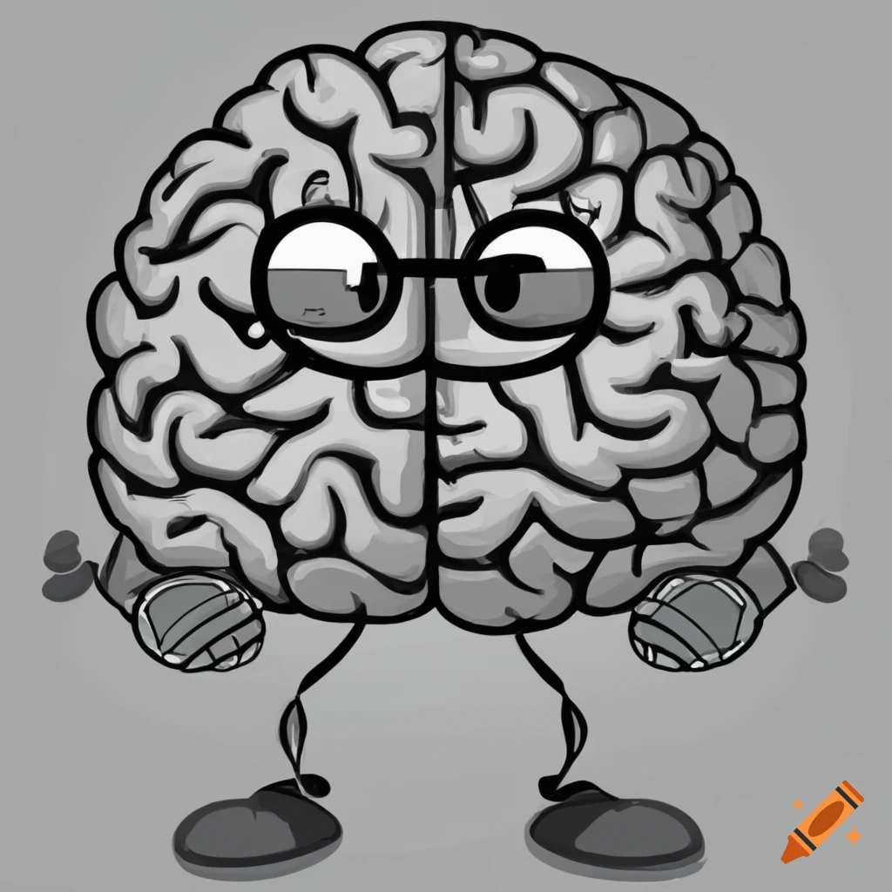
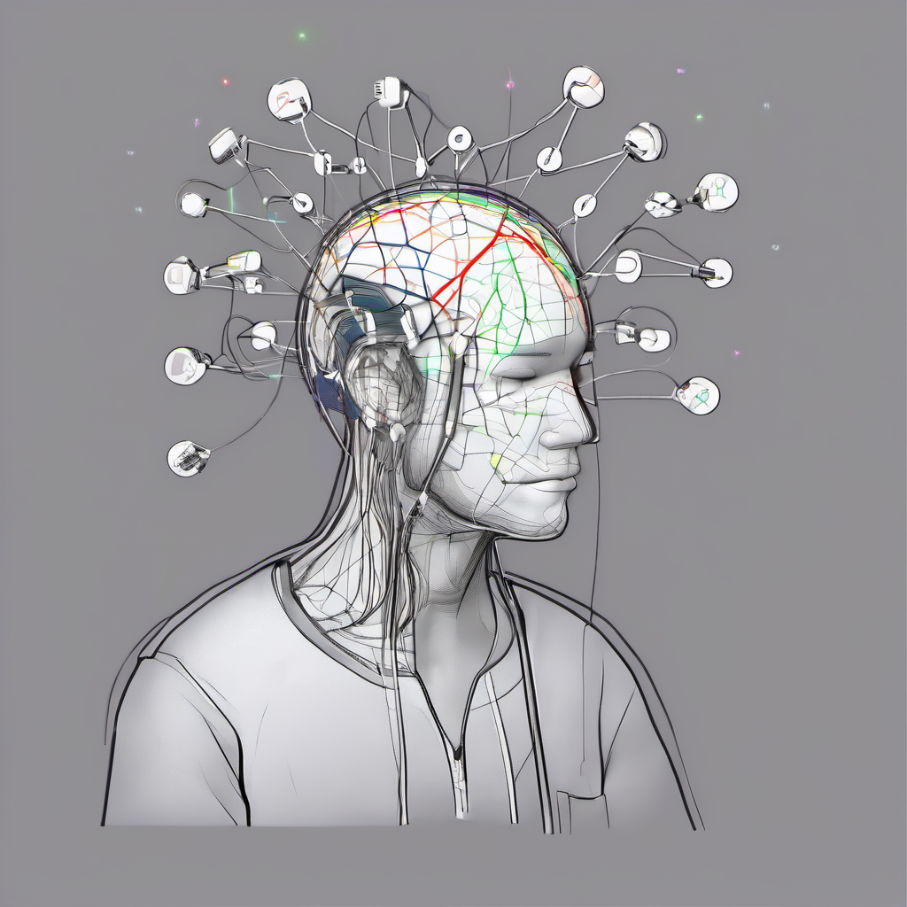

Depression Detection using
EEG Signals
- B24AB02
Kampara Venkata Chaitanya - S20210010104
Jayam Phani Naga Preetham - S20210010096
Cheruku Manjith Kumar Reddy - S20210010054

Slide 2

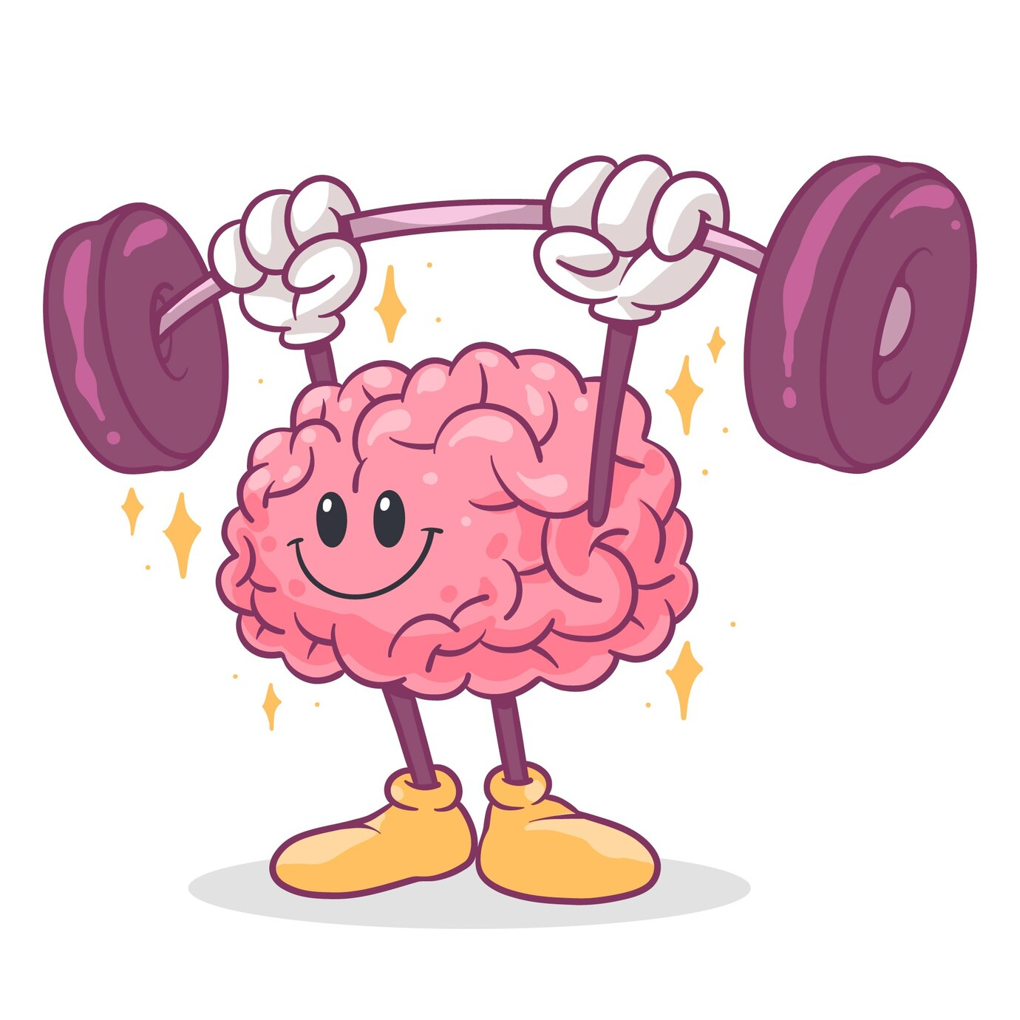
Table of Contents
1
Methodology
2
Implementation of Paper 1
3
Intro to SNN
4
Implementation of Paper 2
5
Timeline
6
References

Slide 3
METHODOLOGY

Slide 4
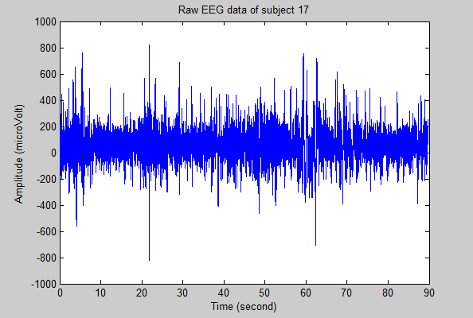
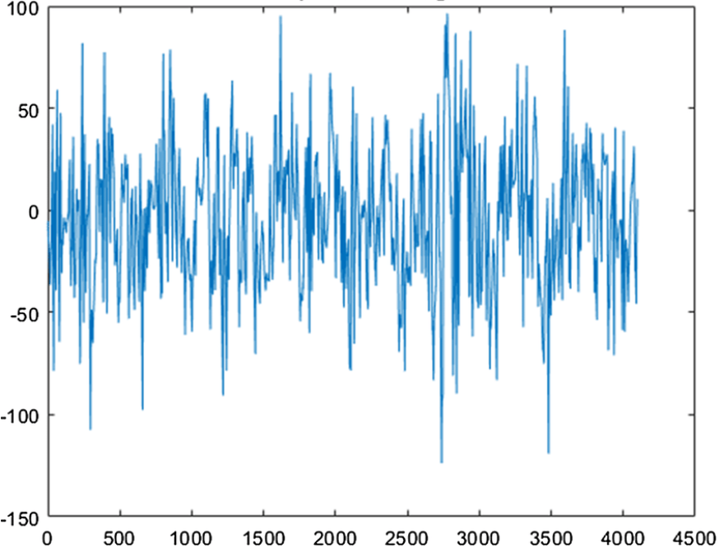
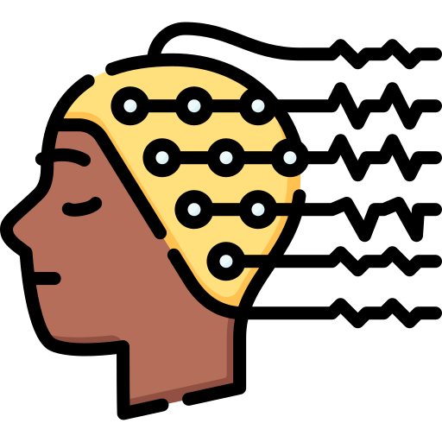
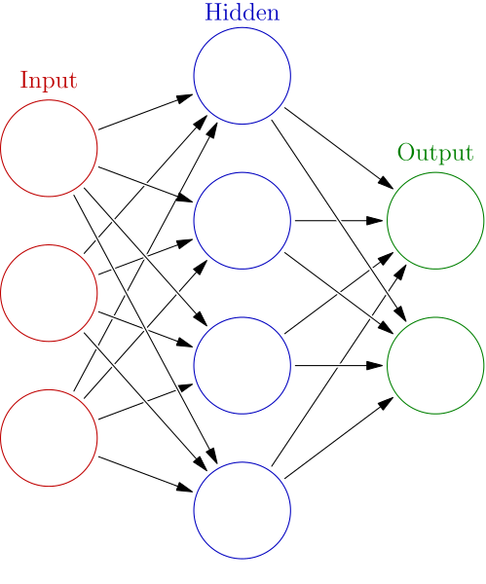



Raw EEG Signal
Preprocessed EEG Signal
Filtering
Feature
Extraction
Data Collection
OR
Healthy
Depressed
Classification Algorithms

Slide 5

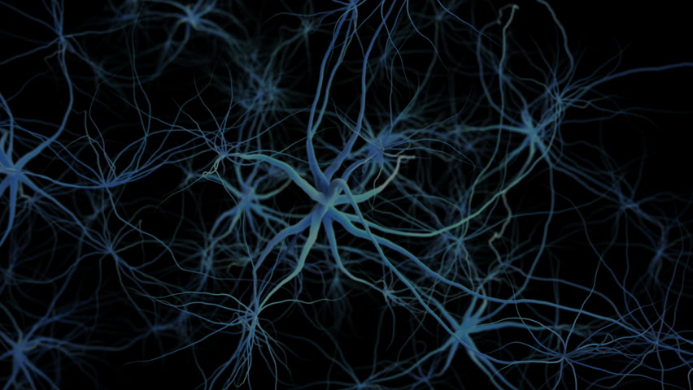
Major depressive disorder diagnosis based on effective connectivity in EEG signals: a convolutional neural network and long short-term memory approach [1]
-et.al.Abdolkarim Saeedi

Slide 6

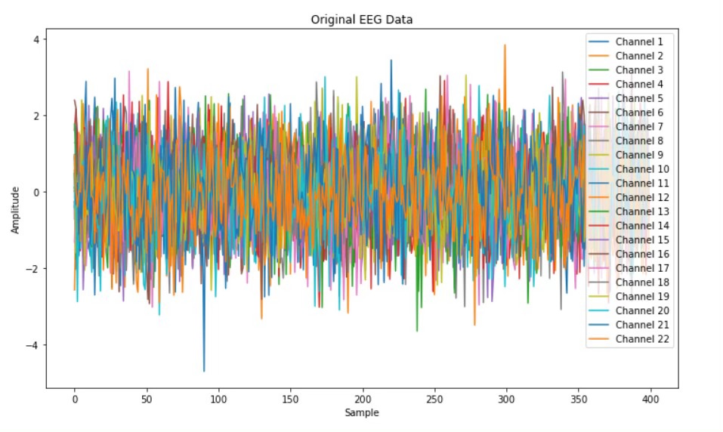
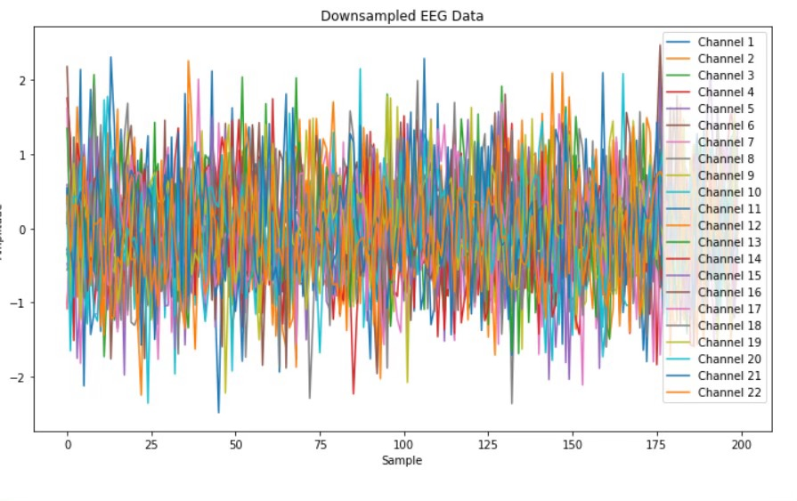
Down Sampling
Downsampling makes it easier for computers to handle EEG data by reducing the amount of information without losing important details.
Downsampling can help clean up noisy signals by smoothing out small fluctuations.

Slide 7
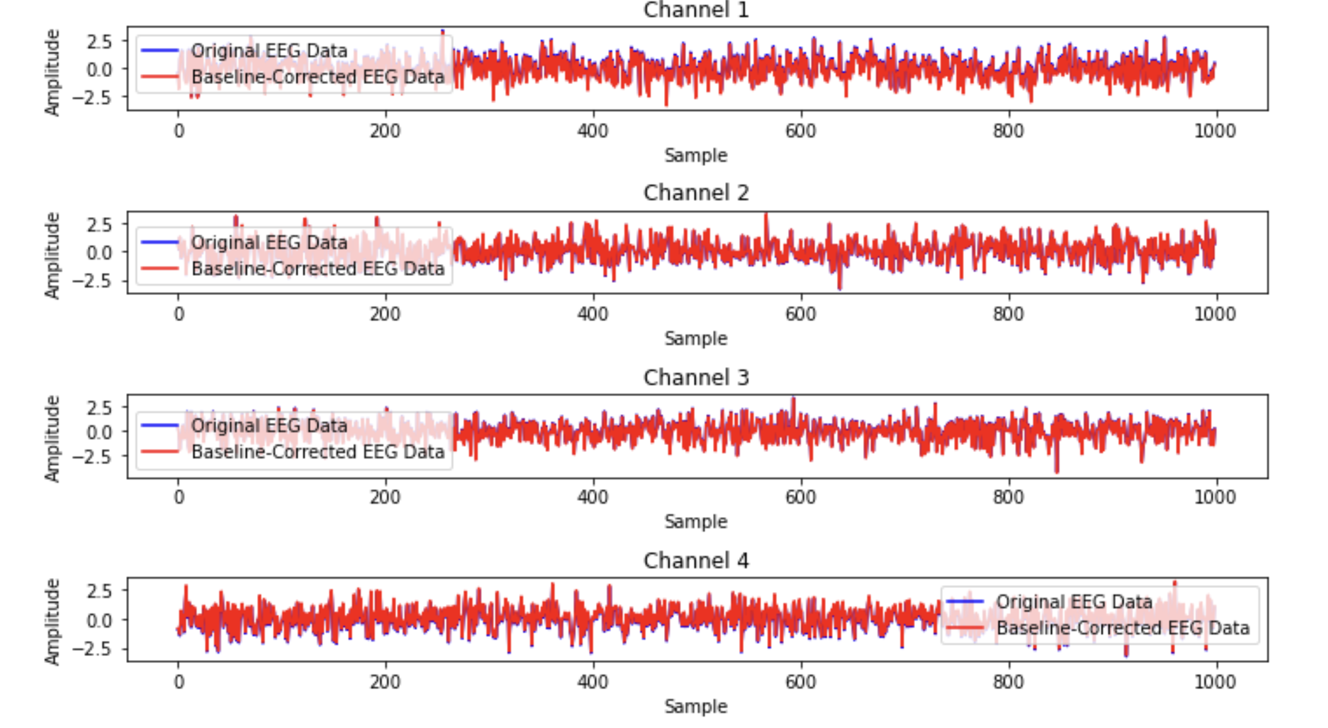
Base line Removal
Baseline removal is a process that resets all spectra to a common baseline

Slide 8
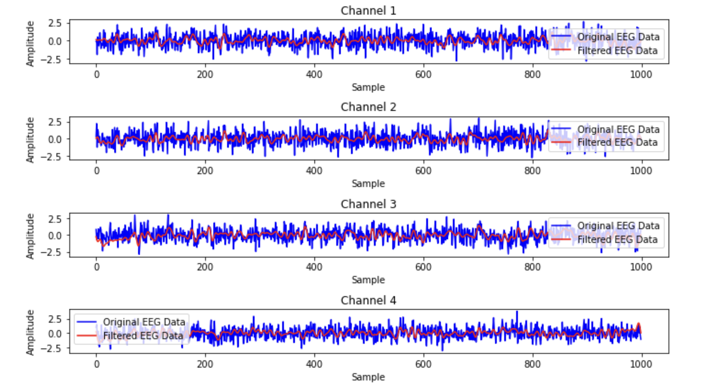
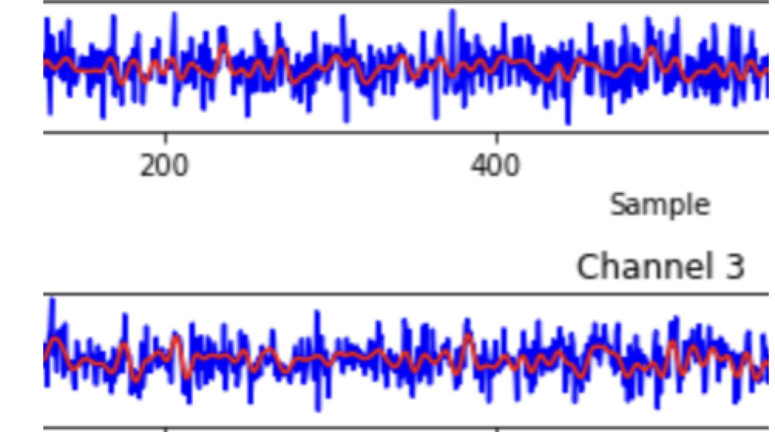
Band Pass Filtering
Allows frequencies within a certain range, while rejecting frequencies outside that range .

Slide 9
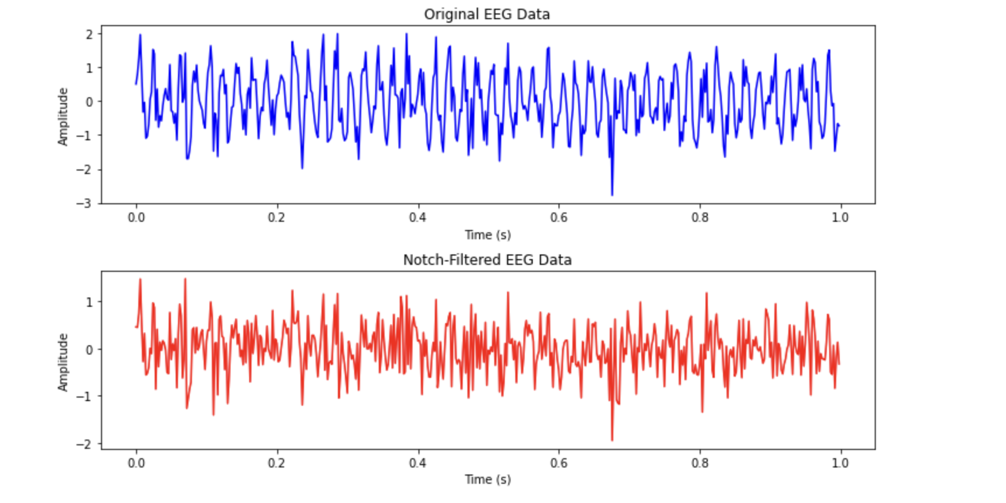
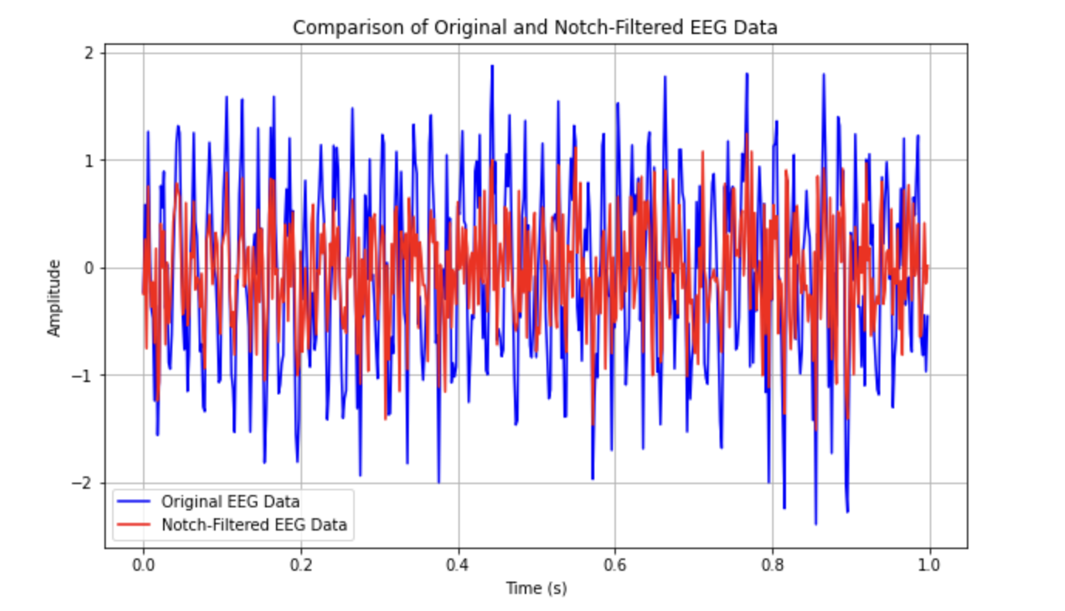

Notch Filtering

Slide 10
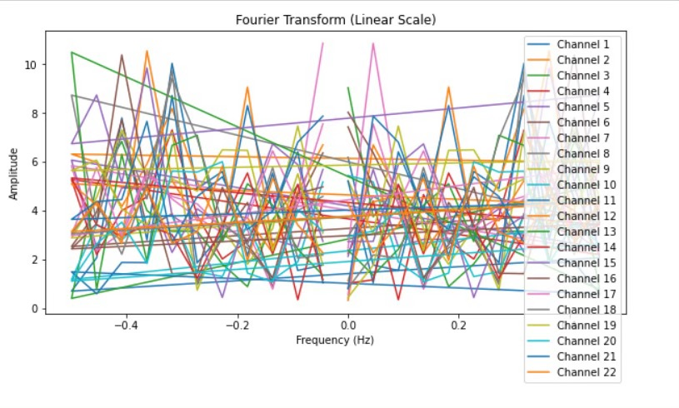
Fourier Transform
Fourier transform decomposes a signal into its constituent frequencies, revealing the frequency spectrum of the signal.

Slide 11
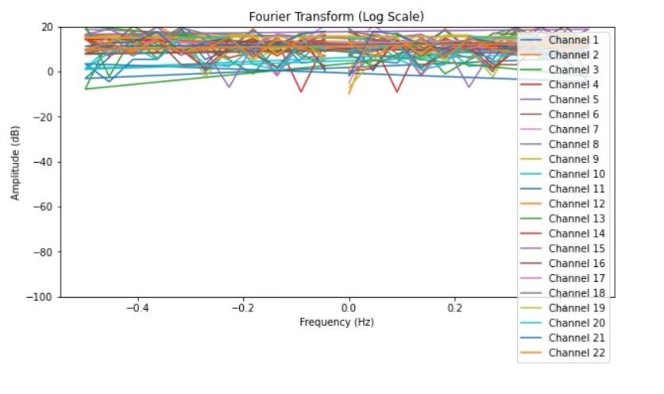
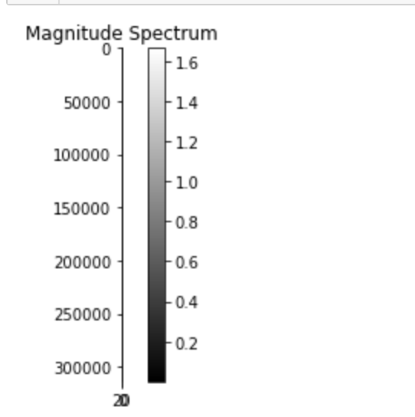
Fourier Transform (Contd)
Brighter regions in the visualization indicate higher intensity or strength of a particular frequency band within the EEG signal.

Slide 12
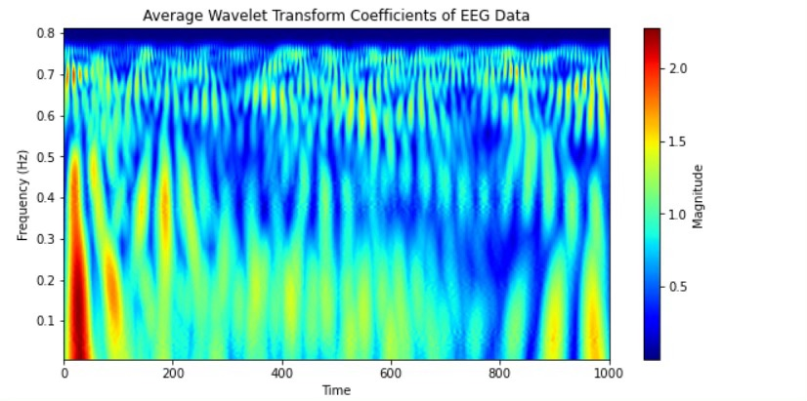
Wavelet Transform
1. Wavelet transform is a mathematical tool used for analysing and processing signals and images at different scales.
2. Unlike traditional Fourier transform, wavelet transform offers both frequency and time localisation, making it suitable for non-stationary signals.
3. It decomposes signals into wavelets, which are small waves of varying frequencies, capturing both high and low-frequency components efficiently.
4. Wavelet transform is widely employed in fields like image compression, denoising, feature extraction, and pattern recognition due to its versatility and effectiveness.

Slide 13
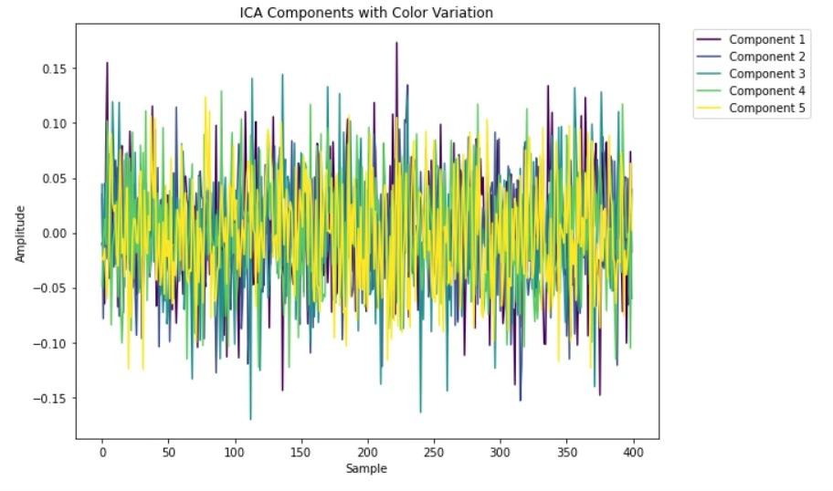
Independent Component Analysis
ICA untangles the mix of brain signals recorded by EEG, revealing individual sources of activity, similar to separating ingredients in a recipe.

Slide 14

Result Comparison
Model | Our Results | Paper Results
1D CNN | 92.579 | 95.283% ± 2.109
1D CNN LSTM | 92.810 | 99.245% ± 1.152
LSTM | 91.11 | 89.057% ± 1.849
2D CNN | 50.13 | 96.226% ± 1.208

Slide 15
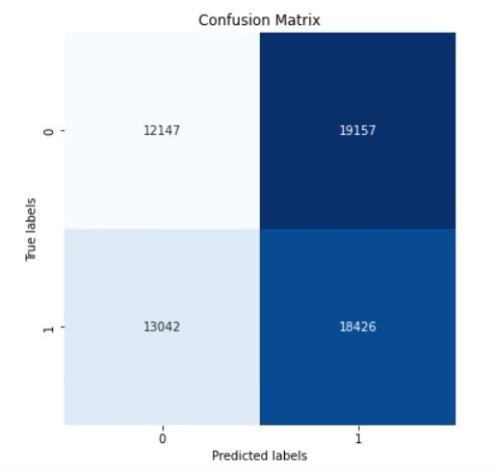
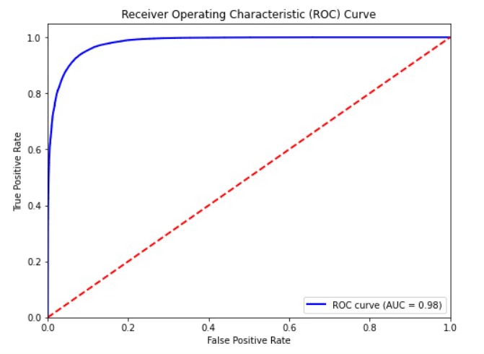
1D CNN
ROC=0.98

Slide 16
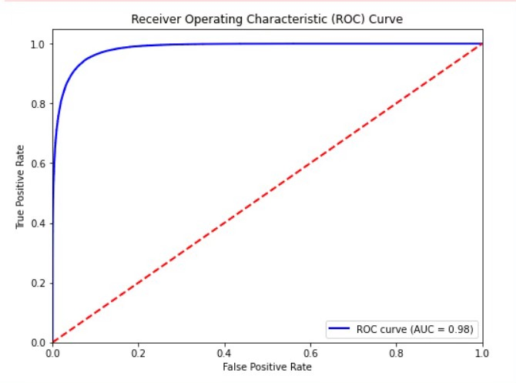
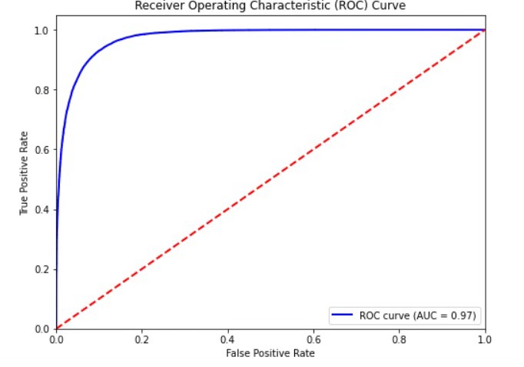
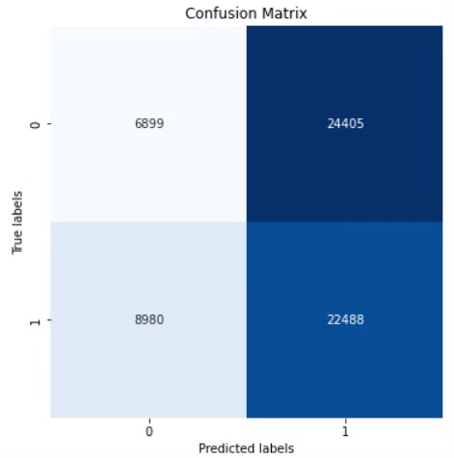
1D CNN LSTM
LSTM
ROC=0.98
ROC=0.97
ROC=0.98
1D-LSTM-CNN
1D-CNN
ROC=0.98

Slide 17
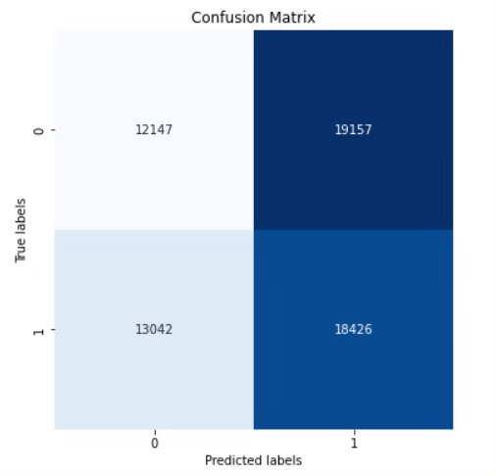
LSTM
ROC=0.97

Slide 18

Depression Identification Using EEG Signals
via a Hybrid of LSTM and Spiking Neural Networks [2]
-et.al.A sam

Slide 19
Intro to SNN
Spiking Neural Networks (SNNs) are a class of artificial neural networks inspired by the biological brain's neural structure and functioning.
In SNNs, information is processed in the form of spikes, which are discrete events representing the firing of neurons. Neurons integrate incoming signals over time and emit a spike when their membrane potential reaches a certain threshold.
Address event representation (AER) approach, a simplified adaptation of the TBR technique, to transform EEG data into spike trains.
SNN initialises a reservoir with random weights and giving sparsity ratio by setting a proportion of connection to 0 (Converts into 3D)
leaky-integrate and fire model (LIF), a representation of a spiking neuron, can be employed to emulate each neuron within the SNN model [49]. Notably, temporal dynamics are integrated into the operations, alongside the synaptic states of the neurons.

Slide 20
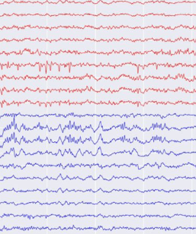
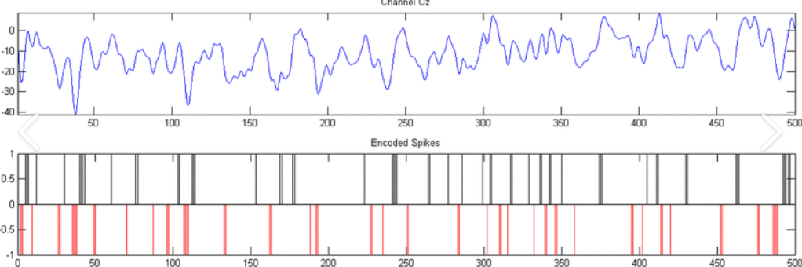
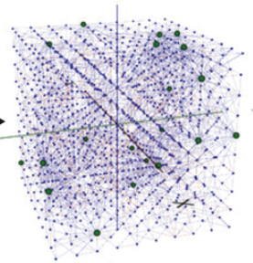
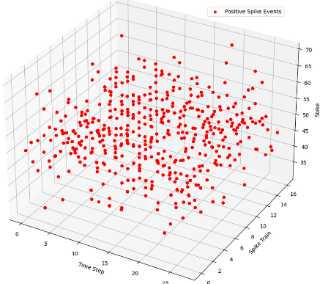
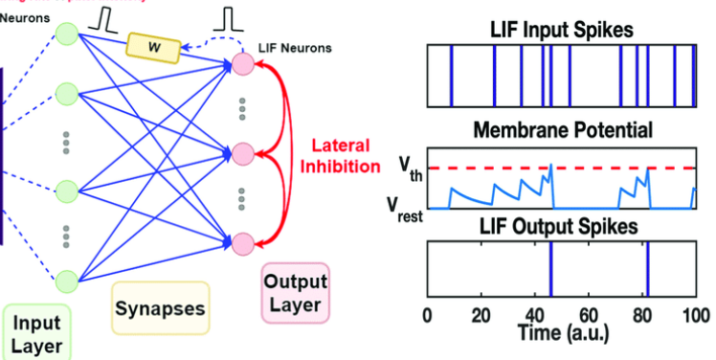
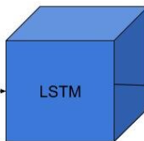
SNN WorkFlow
Spike Encoding
SNN Intialization
EEG Data
OR
LIF Spikes
Healthy
Depressed

Slide 21
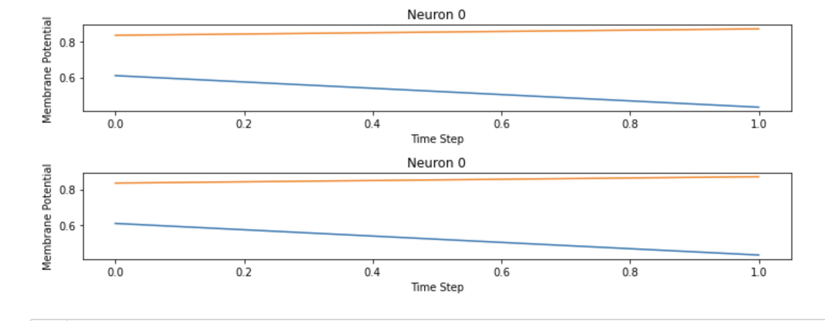
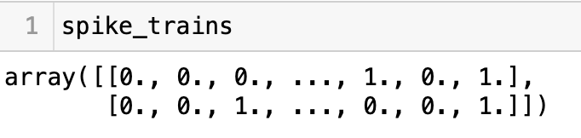
Spike Encoding
SNN Initialisation (2 neurons)
Spike Encoding (binary)

Slide 22
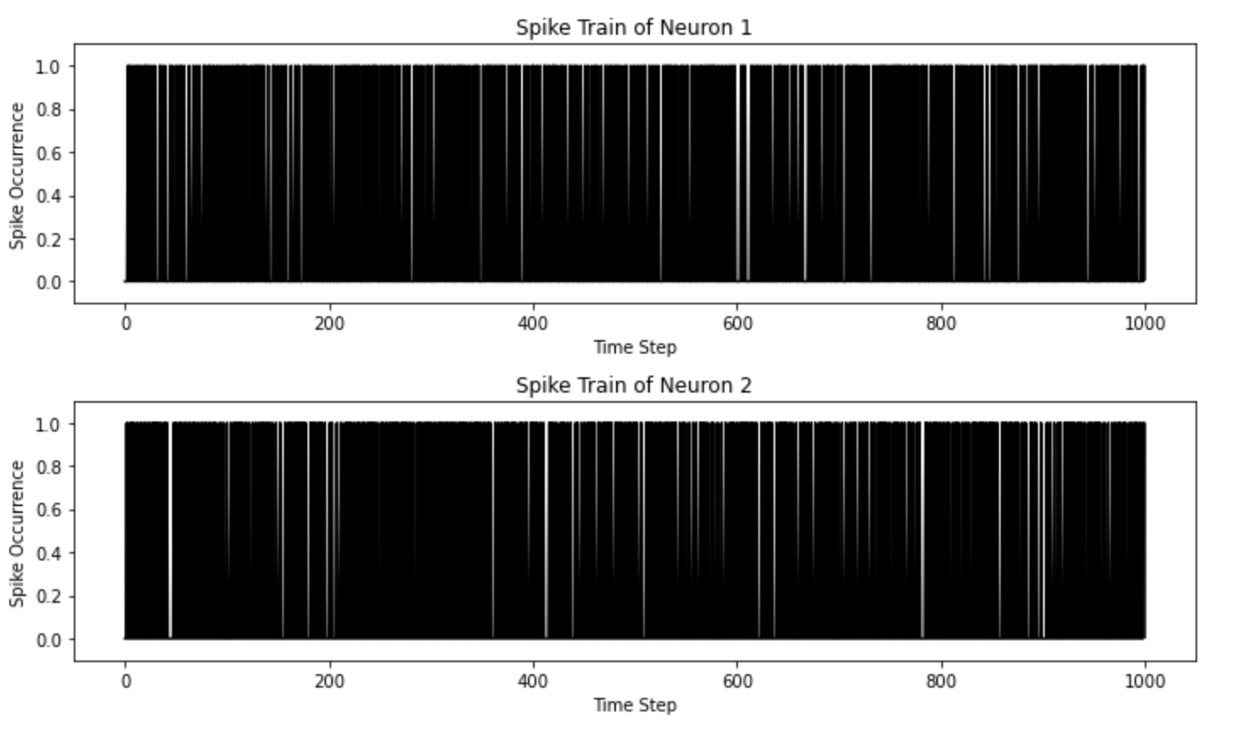
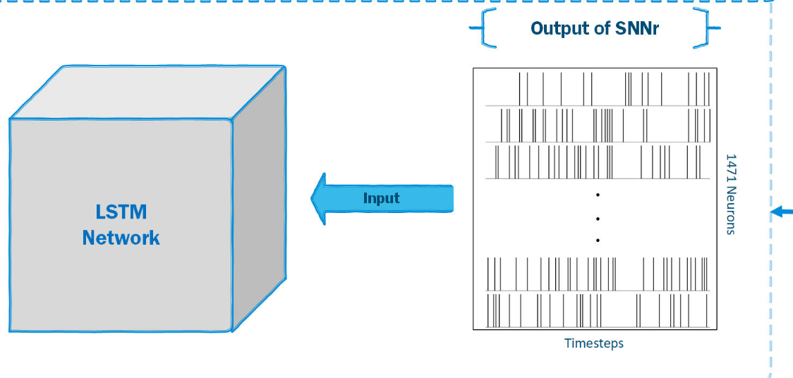
Data Encodings of neurons

Slide 23
Timeline
01
02
03
04
Review 01
Review 03
Review 02
Review 04
Done Literature review by reading various research papers.
Understanding Dataset
Implementation
Preprocessing
Feature Extraction
Classification Algorithms
Collecting and working on Real Time EEG Data
Diving into deep other models to get better accuracy
Creating Structured documentation.
Further Improvements

Slide 24
References
[1] Wajid Mumtaz , Likun Xia , Syed Saad Azhar Ali , Mohd Azhar Mohd Yasinb, Muhammad Hussainc, Aamir Saeed Malik,”Electroencephalogram (EEG)-based computer-aided technique to diagnose major depressive disorder (MDD)”,2016 https://doi.org/10.1016/j.bspc.2016.07.006
[2]A. Sam, R. Boostani, S. Hashempour, M. Taghavi and S. Sanei, "Depression Identification Using EEG Signals via a Hybrid of LSTM and Spiking Neural Networks," in IEEE Transactions on Neural Systems and Rehabilitation Engineering, vol. 31, pp. 4725-4737, 2023, doi: 10.1109/TNSRE.2023.3336467.

